Slide 1



Problem 5:
In the existing business processes, there is currently no dedicated system for managing payroll and expense reimbursement.
This Photo by Unknown author is licensed under CC BY-SA.
This Photo by Unknown author is licensed under CC BY-NC.
Notes:
Finance Manager and the team were spending considerable hours navigating through complex spreadsheets and calculations, leading to errors and delays in salary disbursement.

Slide 2
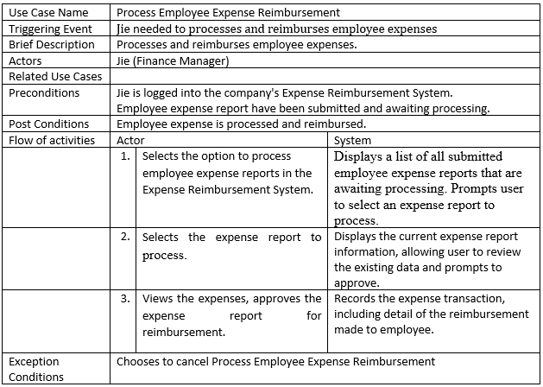
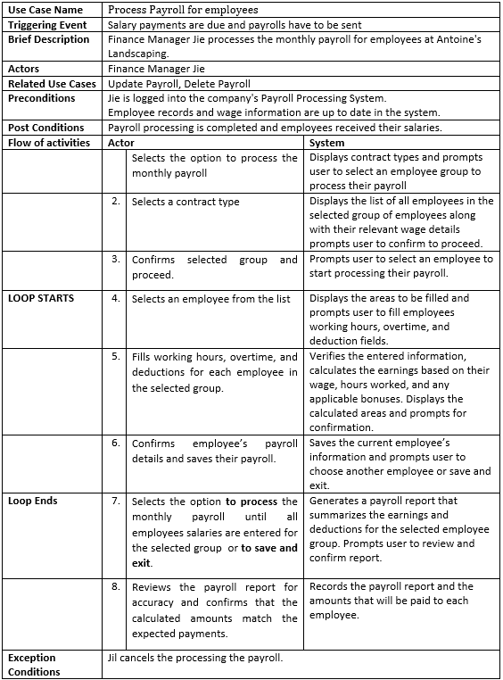
Problem 5: Use Case
Notes:
I come up with these two use cases that I think will be the initiation of the solution of the Payroll Management and Expense Reimbursement.

Slide 3

Solution 5:
To enhance the efficiency of our customers operations, we are planning to integrate comprehensive solutions for payroll management and expense reimbursement into our solution.
This Photo by Unknown author is licensed under CC BY-NC.
Notes:
We are planning to provide ease of operations by integrating a payroll management and an expense reimbursement functionality.

Slide 4
Solution 5 Details:
What business areas did you look at? Who analyzed what?
We focused on examining existing business processes to identify areas for improvement and increased efficiency. I personally conducted the analysis to understand the current workflows at finance department and determine where implementing new functionalities could enhance operations.
What functionality have you researched? Please list the use cases that you found and briefly describe each use case. (use case table)
Process Payroll for Employees : The system calculates earnings, prompting user to confirm details and save each employee's payroll.
Process Employee Expense Reimbursement : The system records the transaction, detailing the reimbursement made to the employee.
Notes:
We focused on the finance teams business process and identified the current workflows needs. After a long research we found two functionalities to make business process of the finance department run smoother.

Slide 5
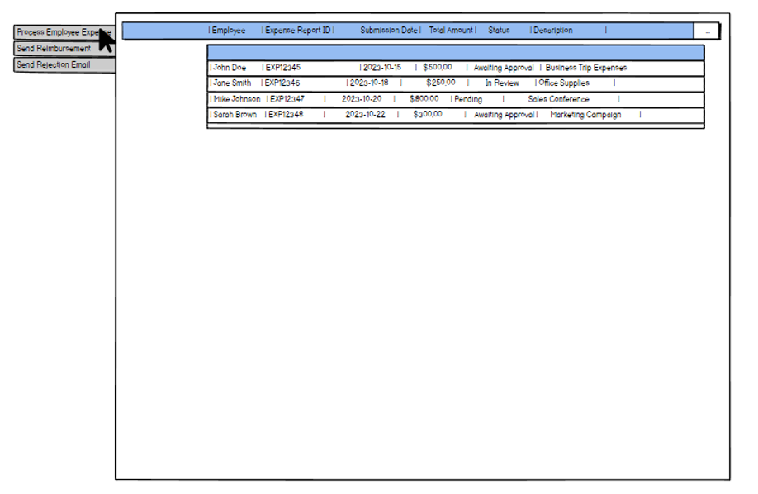

Solution 5: Mockup 1 (1/3)
Process Employee Expense
This Photo by Unknown author is licensed under CC BY-NC.
Notes:
I would like to showcase some mockup designs for my part of the solution. This is the Expense Reimburse systems main page where user can process expense reports, send reimbursement approval/disapproval and email to employee who made the expense.

Slide 6
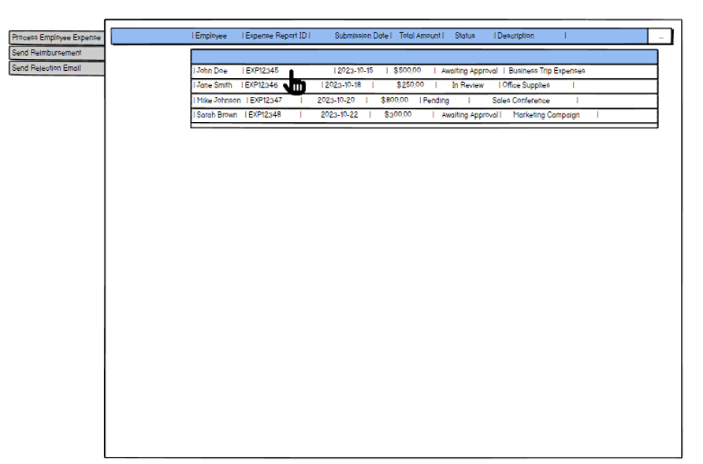

Solution 5: Mockup 1 (2/3)
Process Employee Expense
Notes:
Here we can see how user will select an employee to process an Expense Reimbursement Report.

Slide 7
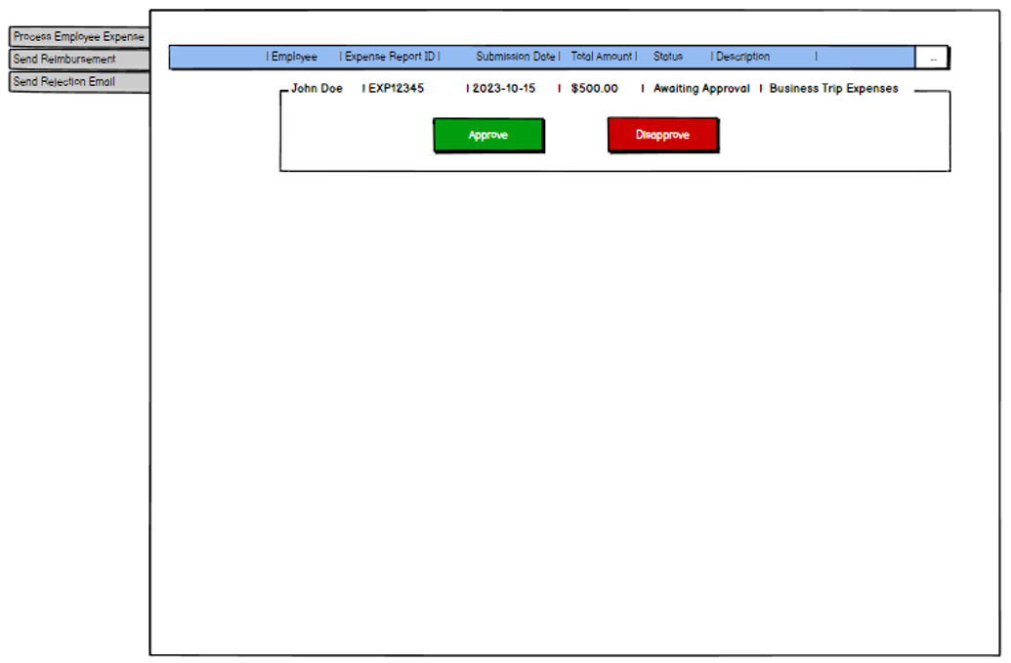

Solution 5: Mockup 1 (3/3)
Process Employee Expense
This Photo by Unknown author is licensed under CC BY-NC.
Notes:
Here we see how user will approve or disapprove the report. Again these are simple mock up designs to give a high level idea.

Slide 8
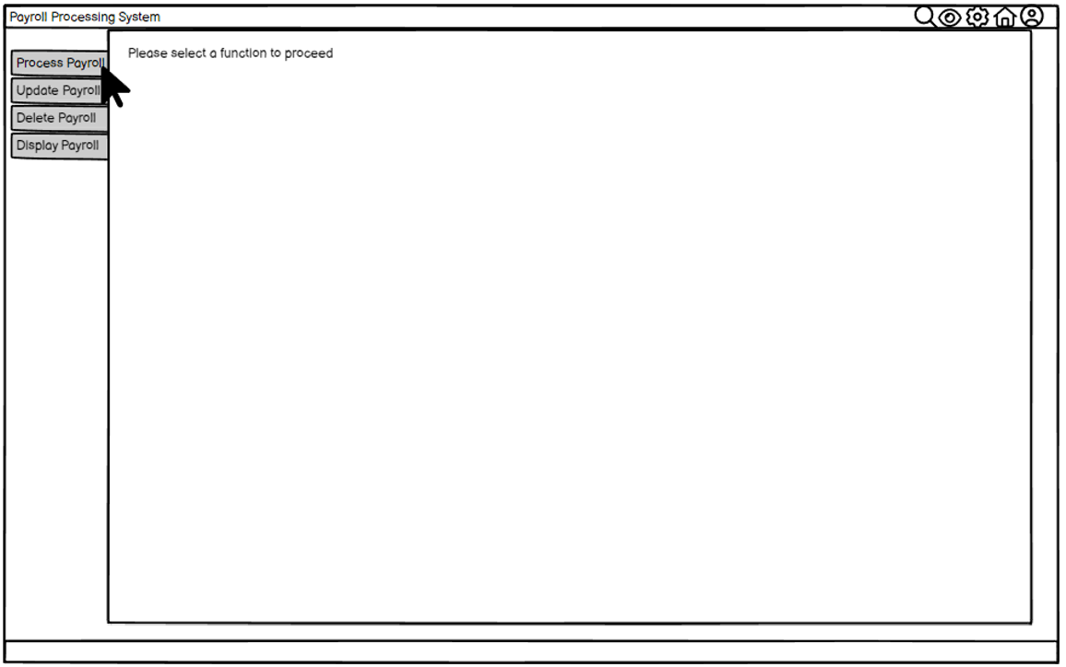

Solution 5: Mockup 2 (1/7)
Process Employee Payroll
This Photo by Unknown author is licensed under CC BY-NC.
Notes:
This is the other solution for my part. Here we see the main page of The Payroll Management system.

Slide 9
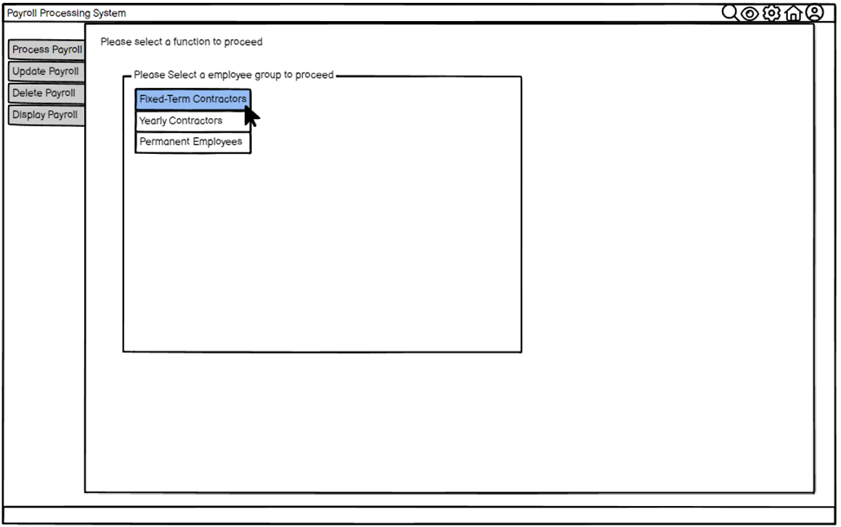

Solution 5: Mockup 2 (2/7)
Process Employee Payroll
Notes:
User can choose employee groups to process payroll in this part of the system.

Slide 10
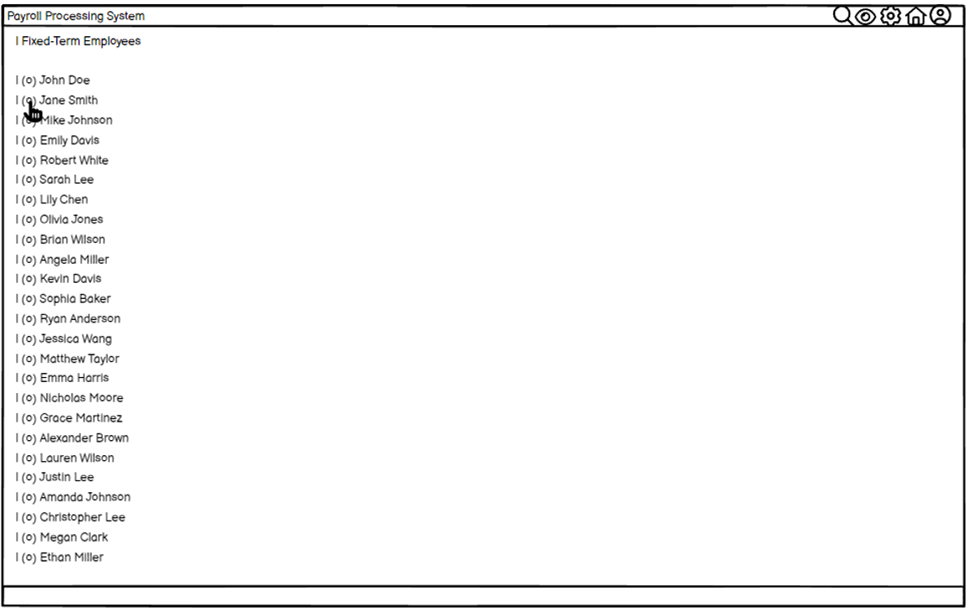

Solution 5: Mockup 2 (3/7)
Process Employee Payroll
Notes:
Here we see the employees that are listed under selected group so that user can choose one of them to start processing their payroll.

Slide 11
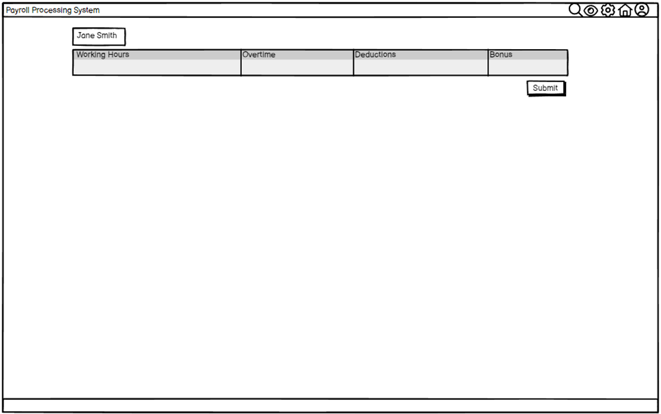

Solution 5: Mockup 2 (4/7)
Process Employee Payroll
Notes:
Here is the empty payroll for the month of this employee.

Slide 12
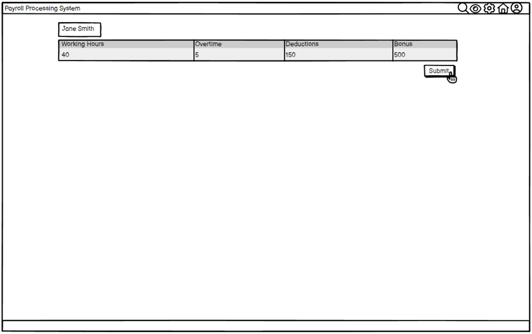
Solution 5: Mockup 2 (5/7)
Process Employee Payroll
Notes:
And this is after filling the payroll report, after filling the report a submit button will appear for user to submit report.

Slide 13
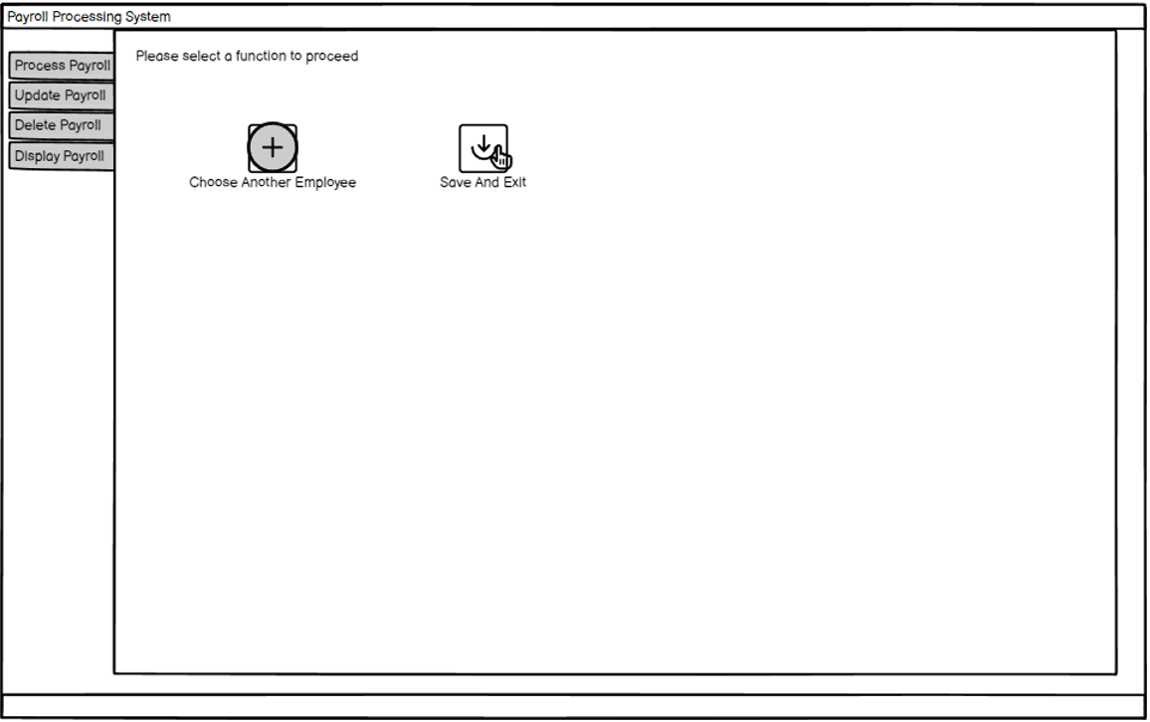

Solution 5: Mockup 2 (6/7)
Process Employee Payroll
This Photo by Unknown author is licensed under CC BY-NC.
Notes:
So user can either save and exit to continue later or choose another employee from the list.

Slide 14
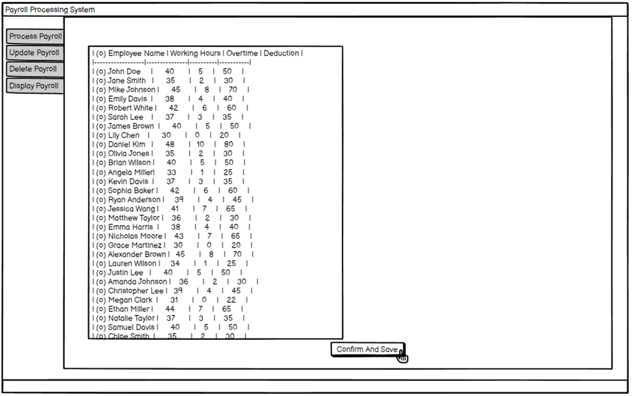

Solution 5: Mockup 2 (7/7)
Process Employee Payroll
This Photo by Unknown author is licensed under CC BY-SA.
Notes:
Lets imagine user processed all payrolls for that group, they can just confirm and save the payroll for the currently selected group.
That concludes my part of the solution in this project. Now, I'll pass it on to my next colleague to speak about their part. Thank you.

